Slide 1
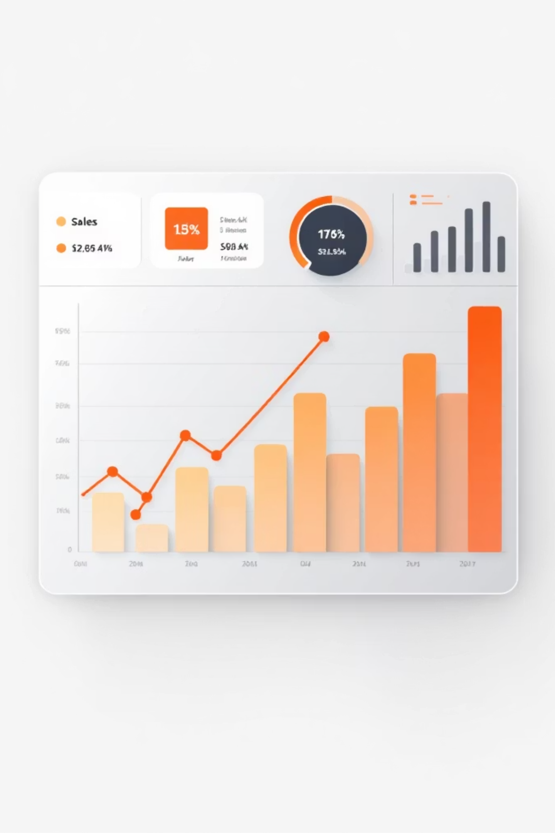
Sales Performance & Revenue Analysis
Date: February 19, 2026 · Sample Superstore (9,977 records)

Slide 2

Executive Summary
Total Sales
Total Profit
Key Driver
$2.30M
$286.24K (12.4% margin)
Discount strategy → strongest predictor of losses

Slide 3

Critical Insight: Discount Impact
High discounts (>30%) produce losses: -$76,552 on $64,225 sales
Discounts explain 29.9% of loss prediction; profit margin 65.9%

Slide 4




Discount Cohorts
No Discount (0%)
Low (1–20%)
Medium (21–50%)
High (>50%)
$846,433 sales · $100,755 profit · 11.9% margin · 13.8% loss
$64,252 sales · -$76,553 profit · -119.2% margin · 100% loss
$1,087,278 sales · $320,844 profit · 29.5% margin · 0% loss
$298,260 sales · -$58,805 profit · -19.7% margin · 91.6% loss

Slide 5


Discount Reduction Scenario
Reduce discounts >30% by 5pp
Profit $286k
Profit before: $286,241
Profit after: $299,218
Improvement: +$12,977 (+4.53%)
Reduce Discounts
Profit $299k
+4.53% Uplift
Zero negative impact on sales volume in simulation

Slide 6


Category Performance
Technology
Office Supplies
Furniture
1,857 orders · $535,424 sales · $59,435 profit · 11.1% margin
6,026 orders · $719,047 sales · $41,535 profit · 5.8% margin
2,094 orders · $742,308 sales · $18,295 profit · 2.5% margin

Slide 7
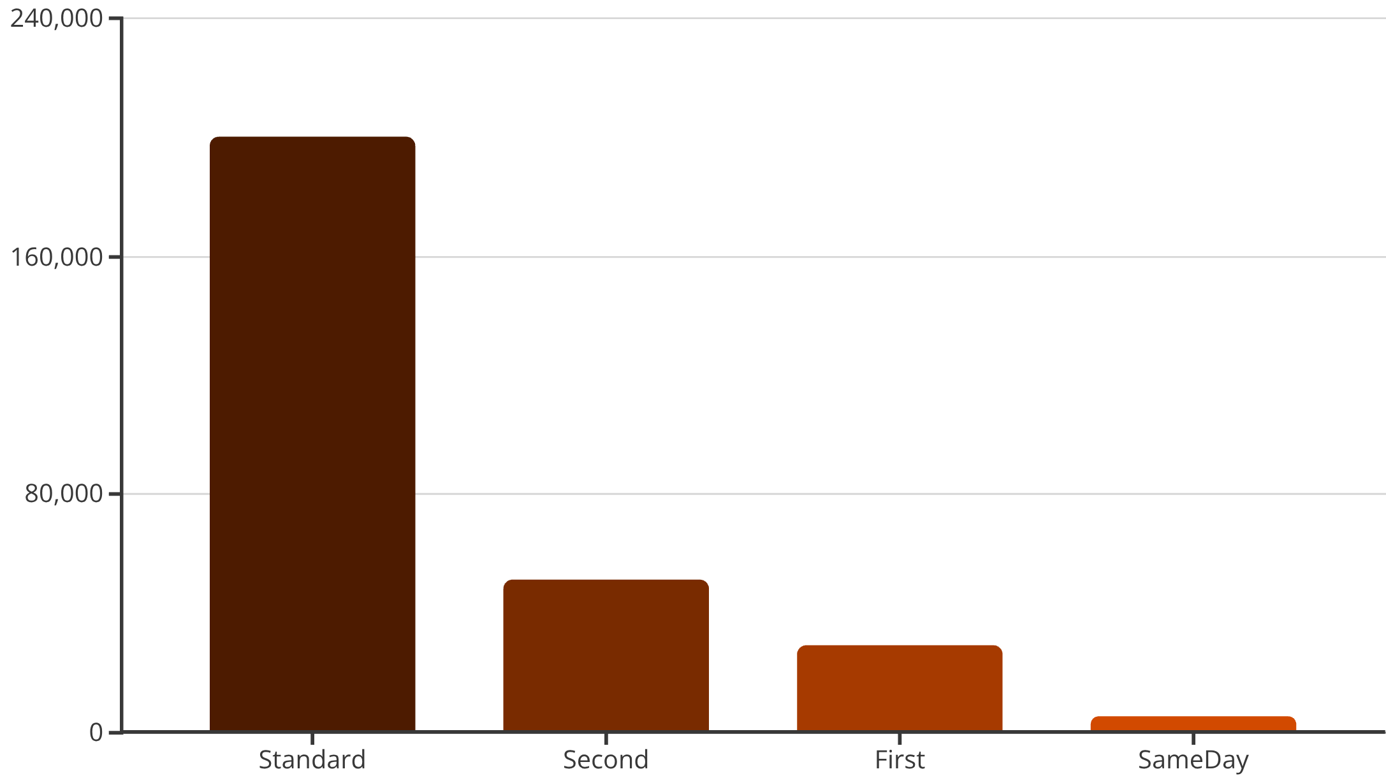
Shipping & Profitability
Standard Class: best margin (15.4%) · 5,968 orders
Express options carry cost burden; consider promoting Standard or surcharging expedited

Slide 8

Regional Performance
West
East
South
Central
$716,194 sales · $112,456 profit · 15.7% margin
$678,543 sales · $95,234 profit · 14.0% margin
$654,291 sales · $78,554 profit · 12.0% margin
$281,250 sales · $0 profit · 0% margin — immediate attention

Slide 9

Model & Feature Importance
Random Forest for loss prediction — exceptionally accurate
Accuracy: 100% · Precision/Recall/F1: 1.00
Top features: Profit Margin (65.9%), Discount (29.9%)
Measure Discount
Predict Loss Orders
Apply Policy Actions
Discount + margin = 95.8% of predictive power

Slide 10

Recommendations & Next Steps
Week 8+
Week 4–8
Review pilots, scale successful actions — target +$135K profit recovery
Week 2–4
Pilot category strategies (shift promos to Technology)
Week 1–2
Audit Central region pricing & discounts
Implement discount caps · eliminate >50% discounts
Primary focus: aggressive discount management → biggest ROI

